Slide 1
Flavour Network and the Principles of Food Sharing
Sai Sruthi Talluri 201301143
Khyati Mahajan 201301406

Slide 2
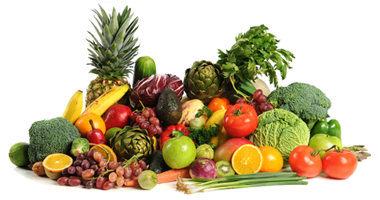
The Food Network
Food networks have been used in the past to analyse food pairings with regards to every cuisine majorly present, mostly with regards to choosing which flavour goes with what. This is known as food pairing, and is majorly affected by taste components more than any other aspect of food like smell, texture, etc.
We present findings of world cuisine and Indian cuisine with regards to the principles of Ayurveda called Viruddha Aahaar.

Slide 3
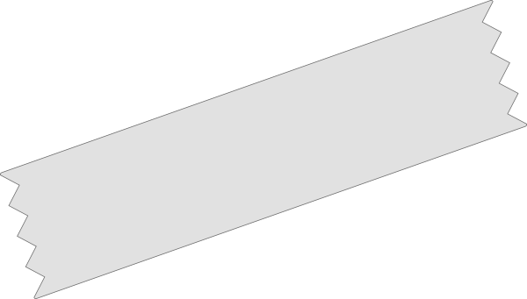

Introduction
Food pairing choices go both ways, according to network analysis:
Positive pairing Food that has similar taste components is preferred to comprise a meal, ex. North American cuisine
Negative pairing Food that has conflicting taste components is preferred, ex East Asian cuisine

Slide 4
Whatever the pairings are, do they follow a general pattern with regards to incompatible food pairings?
Point
You’ve surely tasted food that does not go well together, leaving an aftertaste usually confusing.

Slide 5
Ayurveda explains this using the concept of
Viruddha Aahaar.
(We’ll get to it)
Point
Ayurveda is the science of maintaining umpteen health by insuring what you eat is your medicine.

Slide 6
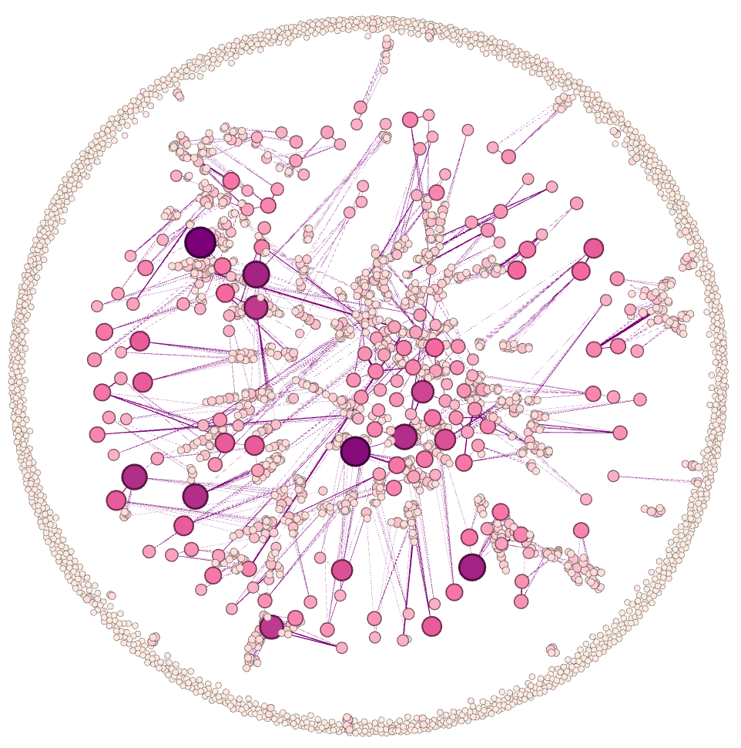
The Food Network
We conducted analysis on this network of ingredient pairs taken together and used all over the world.
The visualisation portrayed how there are ingredients that are used most frequently and how they form the major connected portion of the graph. It also showed how lesser used ingredients lie on the periphery, with very few connections otherwise.

Slide 7
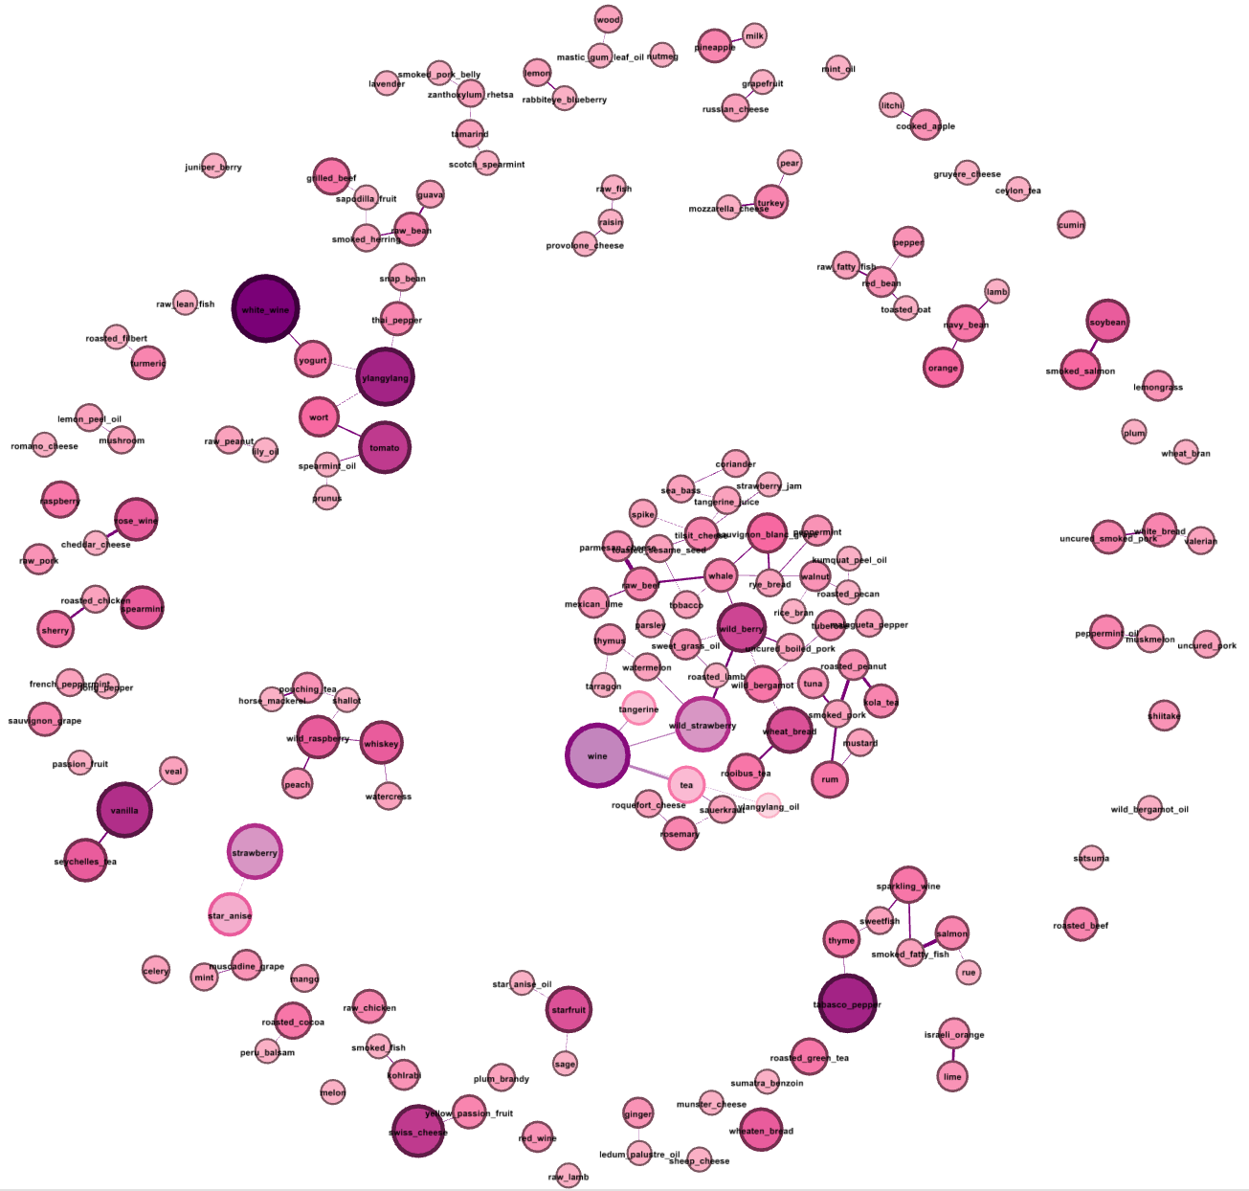
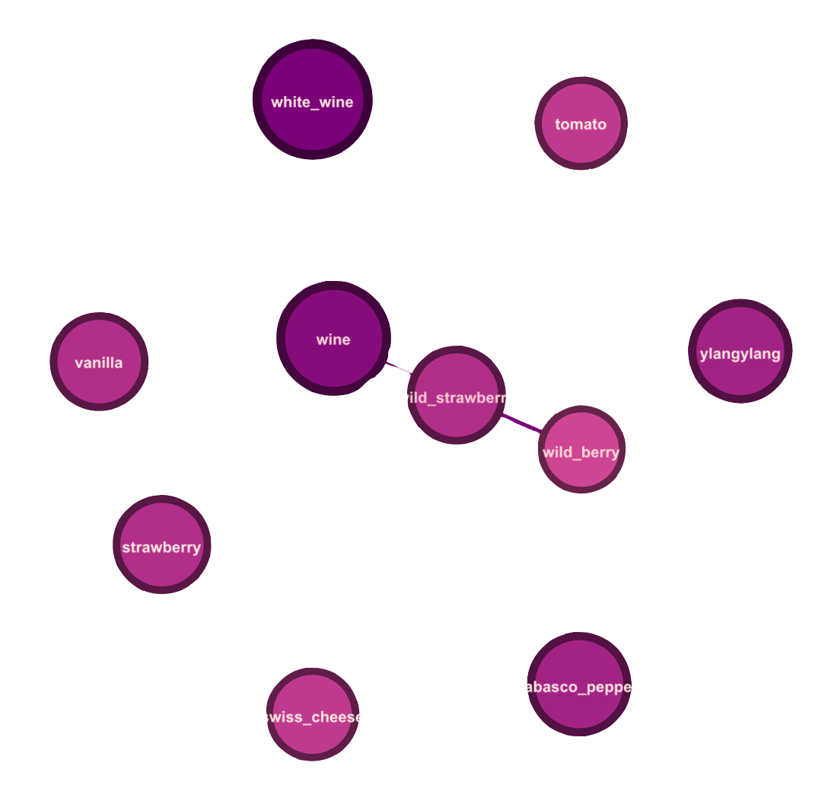
Filtered higher, the most used components are revealed, some still connected to each other.
In all these components, we see that the connected components are not in the Viruddha Aahaar list. The other components, while they are the most used, are not used together.
Filtered Components for higher degrees
When filtered for only higher degree components, the graph reveals the most used ingredients.

Slide 8
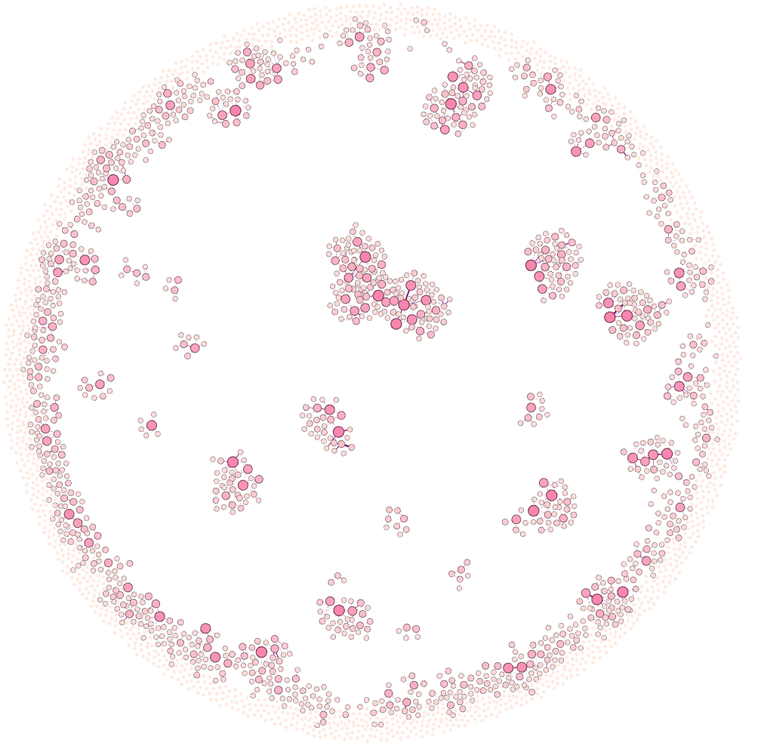
Filtering components for lower degrees
When majorly connected ingredients are removed from the graph, the rest of the components scatter and shrink, forming many small connected components.

Slide 9
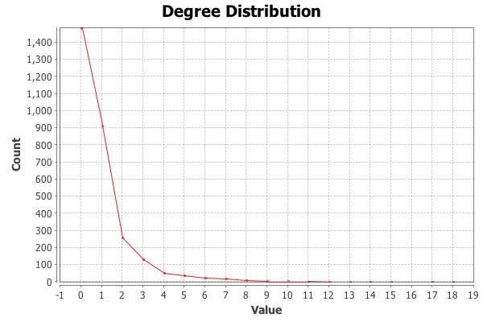
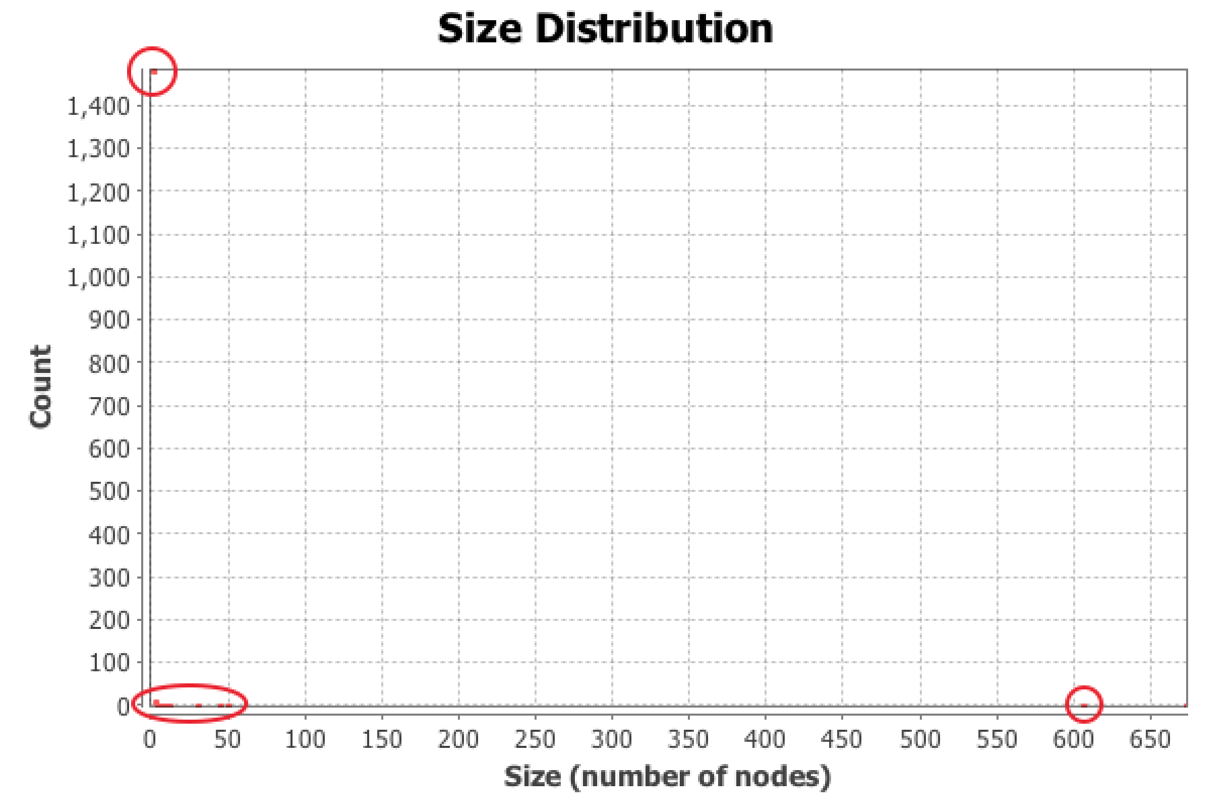
Network: Degrees and Components
The degree distribution of the network follows the power law distribution.
The connected components graph shows that there are a large number of small components and small number of large components.

Slide 10
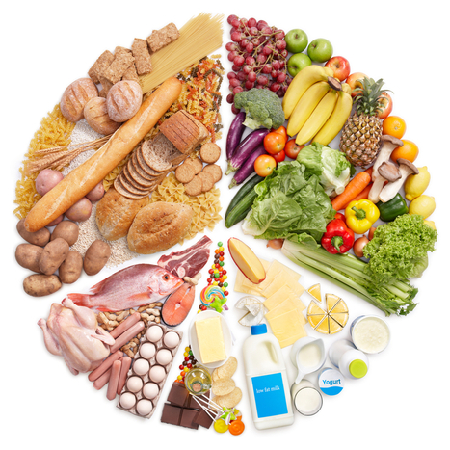
There are some incompatible food combinations described by Ayurveda, called Viruddha Aahaar. It is said that eating these ingredients together might cause toxins to be released in the stomach.

Slide 11
Examples
Some examples of Viruddha Aahaar considered for the project:
10 such pairs were taken from http://www.medindia.net/patients/lifestyleandwellness/dietary-dos-and-donts-of-ayurveda-incompatible-food-combinations-virudh-aahar.htm
Ingredient 1 | Ingredient 2
Milk | Fish, Banana, Melon, Orange, Lemon, Chicken
Banana | Yogurt, Buttermilk
Sesame | Chicken, Fish

Slide 12
Analysis of Indian and world recipes for Viruddha Aahaar
We counted the number of edges of Viruddha Aahaar pairs in the various recipes and tabulated the percentages (approx.) of recipes containing such pairs.

Slide 13
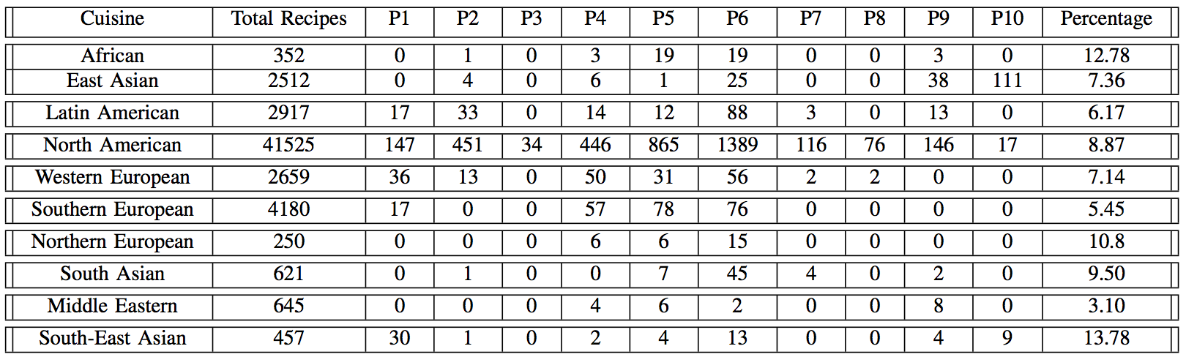
Table for World Cuisines

Slide 14
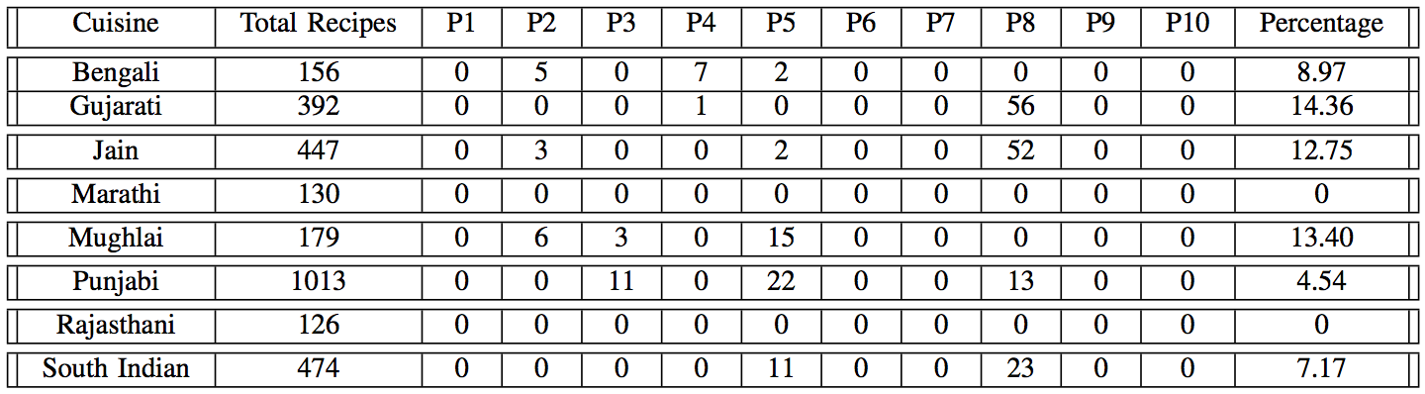
Table for Indian Cuisines

Slide 15
Closing
The tables show that the following points are observed:
Low Percentage The low percentages show that the combinations are generally avoided all over the world.
Similarity in World and Indian Cuisine The similarity in both the cuisines is evidently seen with regards to the Viruddha Aahaar.

